Slide 1

Notes:
5

Slide 2
Market Opportunity
TAM
$40 bn
SAM
62 M (2023)
SOM
3~6M users
Sources: Cognitive Market Research (Adventure Tourism 2024), Grand View Research (Hiking Gear 2024), Outdoor Foundation (Participation 2024)
Notes:
5

Slide 3
Revenue Opportunity
Revenue Stream | ARPU | Annual Revenue
Premium Subscription $5.99~7.99/mo | 3M users × 8% × $72 | $17M
Group Tools $30~50/mo | 10,000 groups × $480 | $5M
Gear Affiliate 5% per order | 3M users × $5/year | $15M
 | Total Revenue | $37M
Sources: Cognitive Market Research (Adventure Tourism 2024), Grand View Research (Hiking Gear 2024), Outdoor Foundation (Participation 2024)
Notes:
5

Slide 4
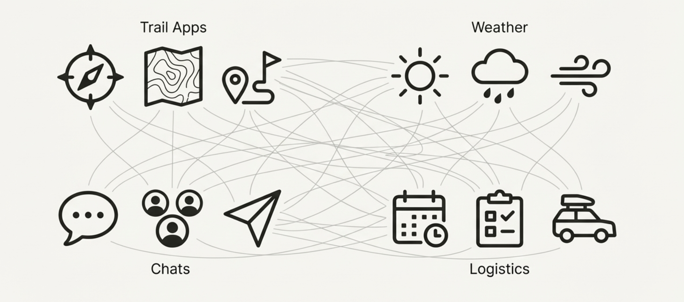

Slide 5
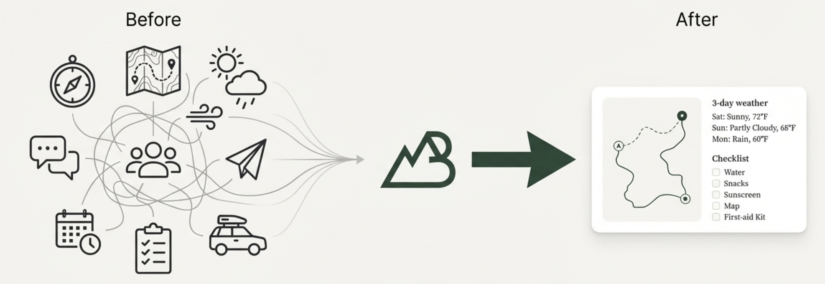

Slide 6
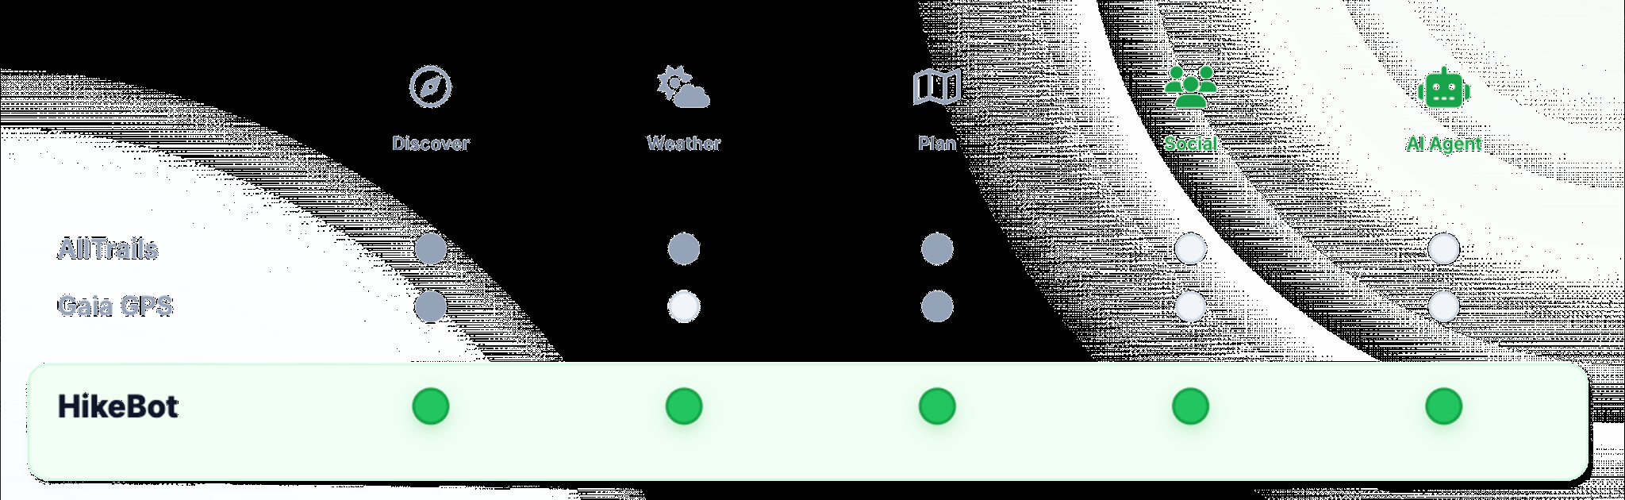

Slide 7
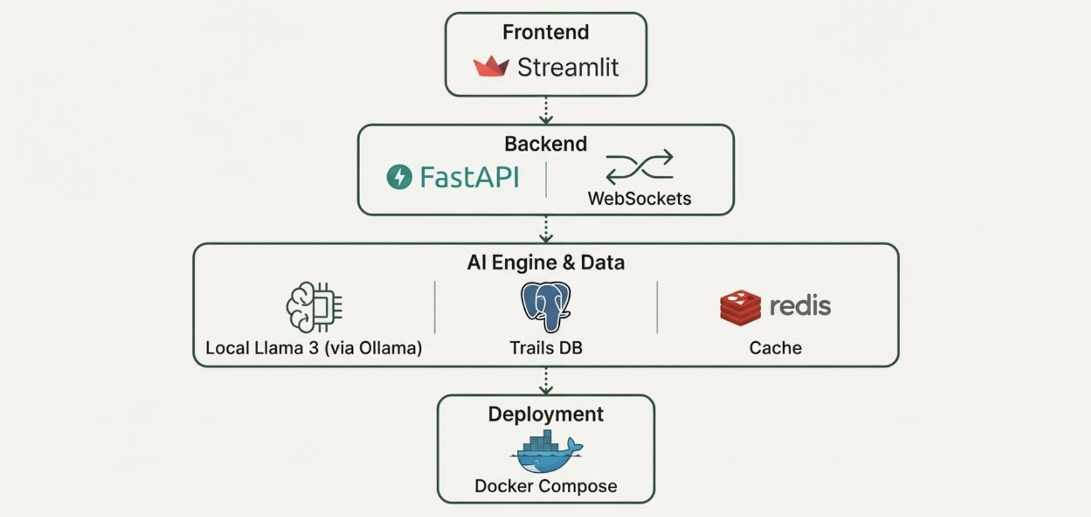

Slide 8
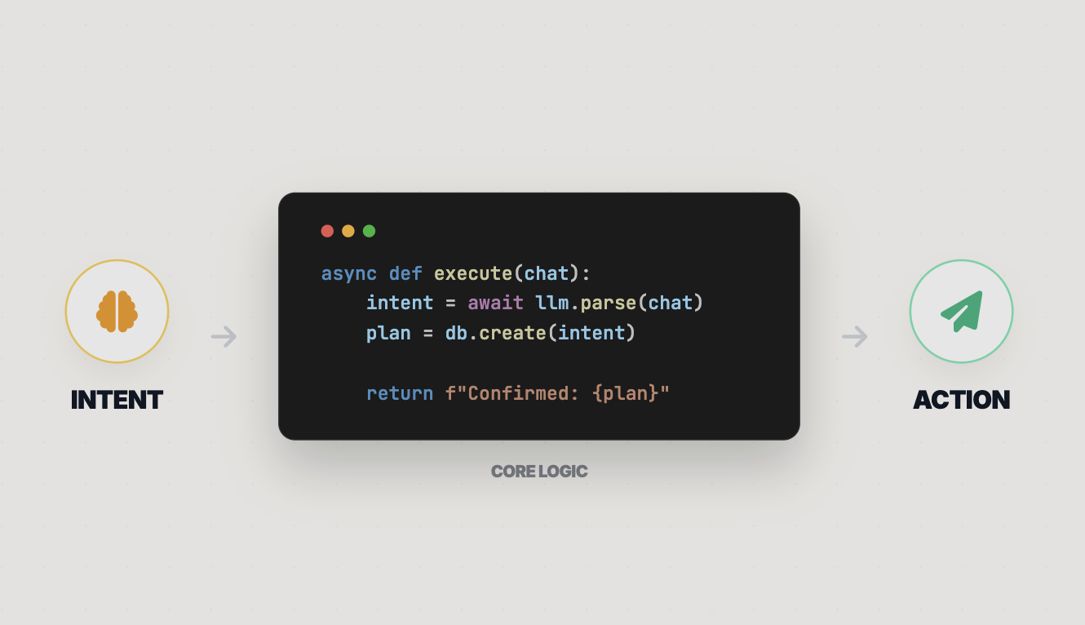

Slide 9
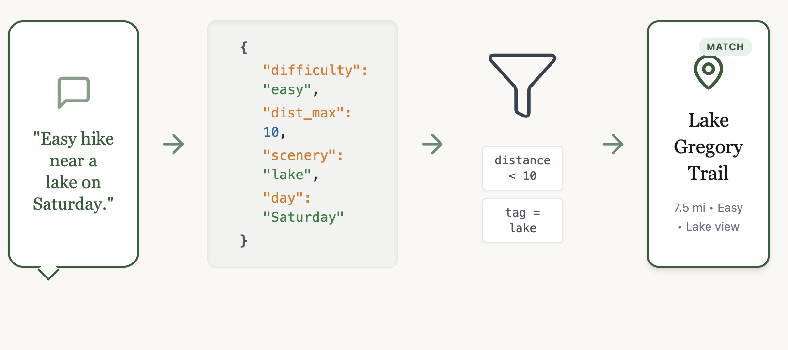

Slide 10

THANK YOU
Ready for the next adventure?

